Slide 1
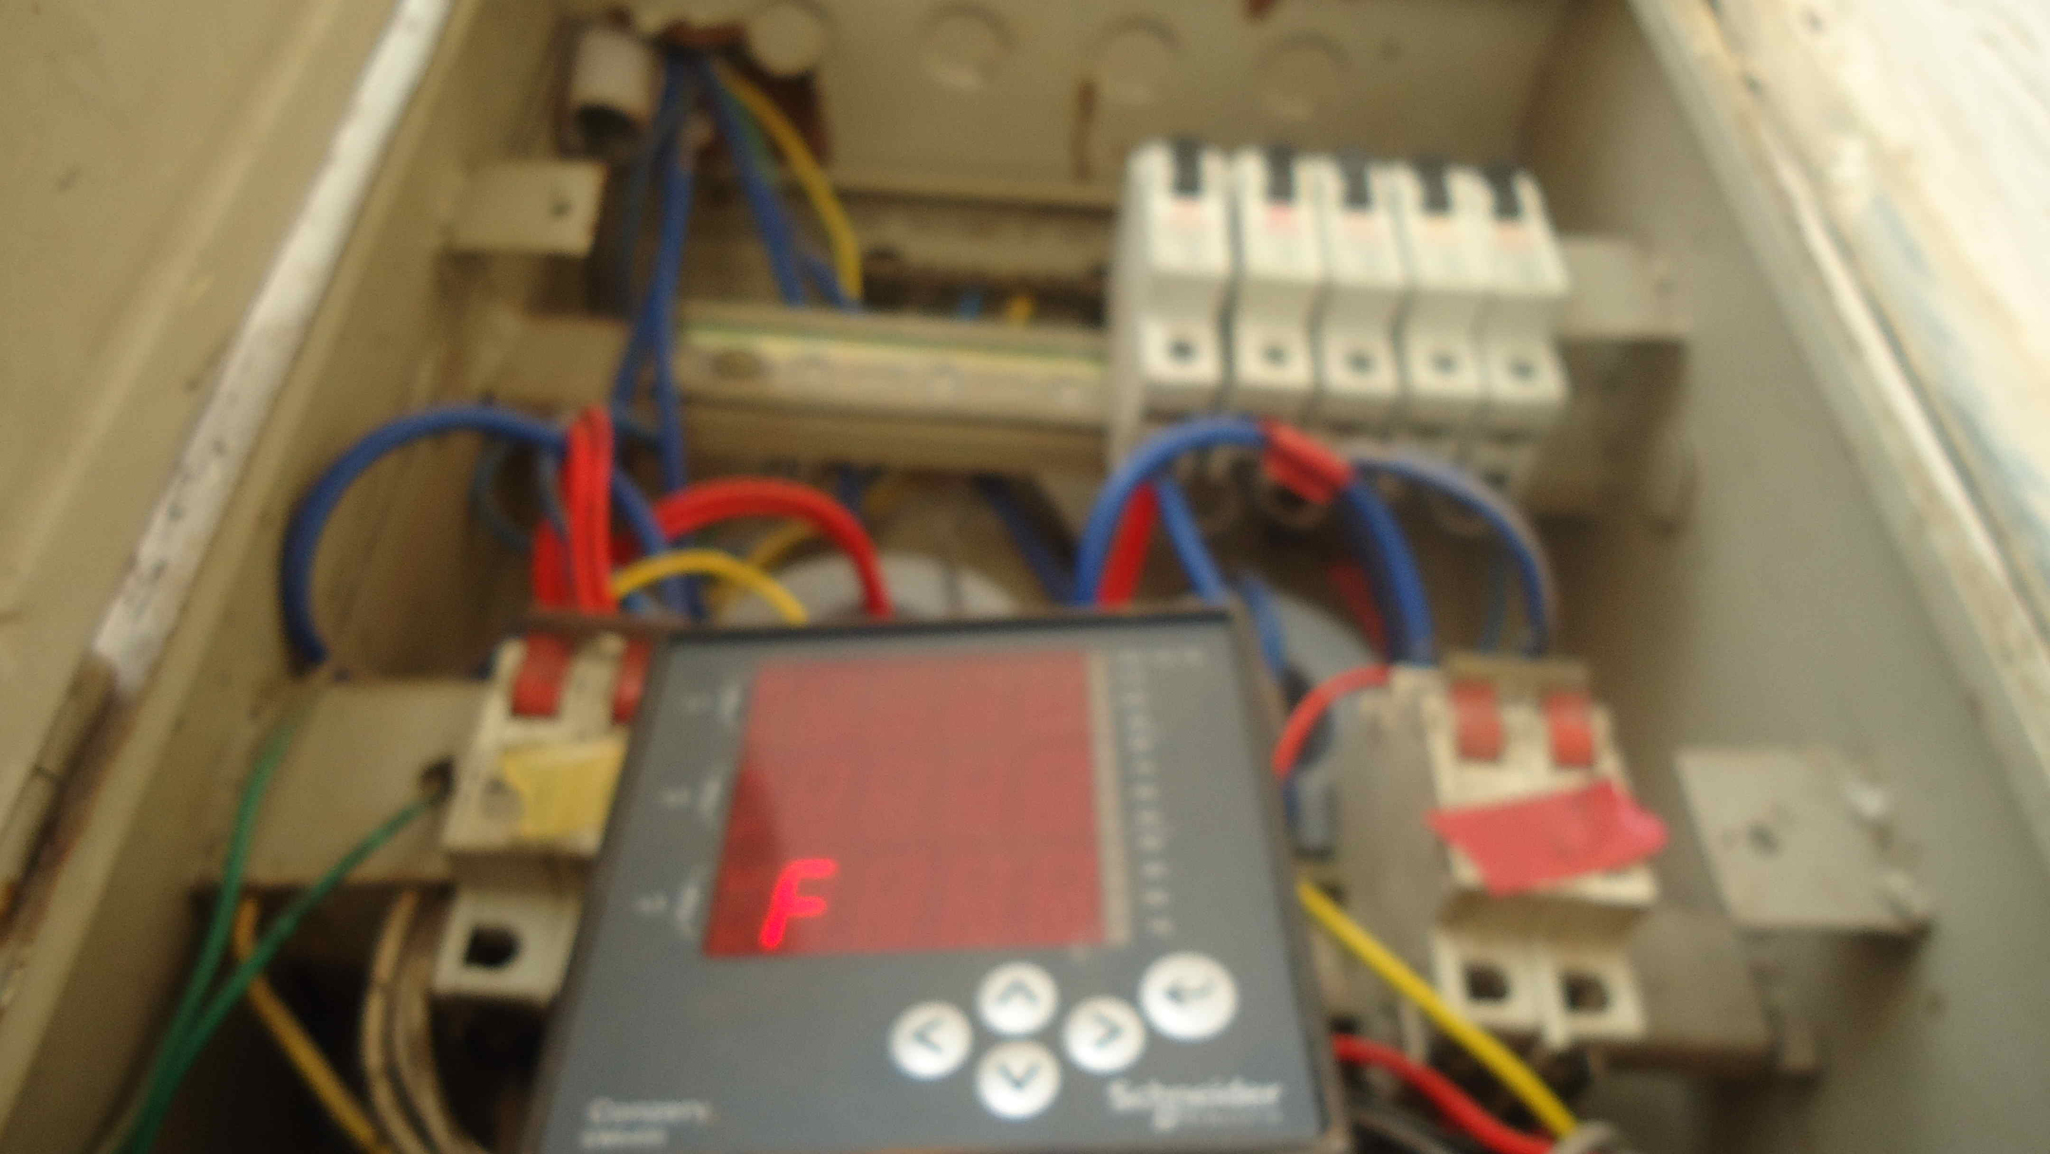





NILMTK
An Open Source Toolkit for
Non-intrusive Load Monitoring

Slide 2
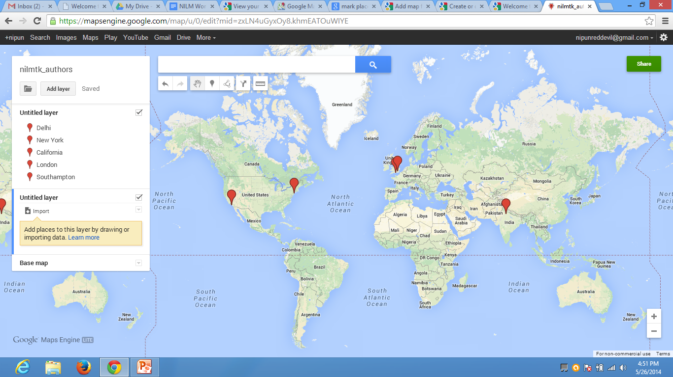


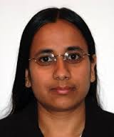





NILMTK team
Haimonti
Dutta
Alex Rogers
Nipun Batra
Oliver
Parson
Mani Srivastava
Amarjeet Singh
William
Knottenbelt
Jack Kelly

Slide 3
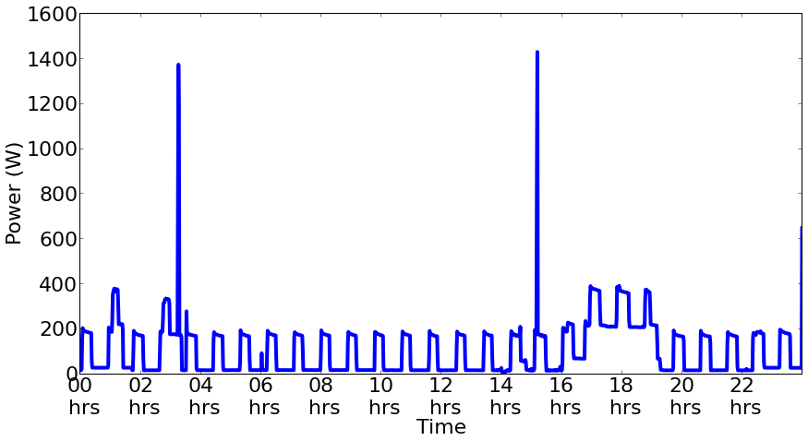
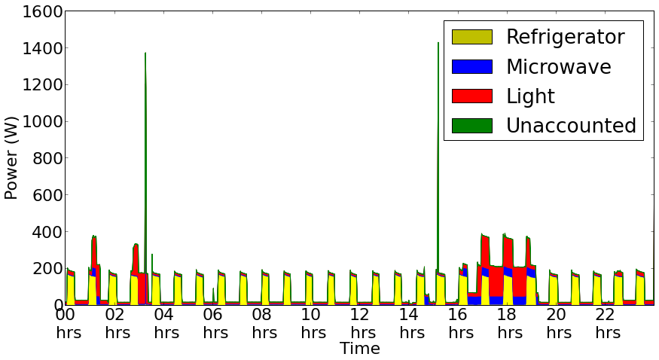
Non-intrusive load monitoring (Energy disaggregation)
“Process of estimating the energy consumed by individual appliances given just a whole-house power meter reading”

Slide 4
Wait a minute! This sounds complicated Would it help?

Slide 5
Jane goes to the market

Slide 6
Jane spends 200 pounds on her purchases

Slide 7
Jane’s husband John is worried with the expenses

Slide 8
He spends some time and looks at the purchase list

Slide 9
Do you think the itemized billing helped him?
NILM is the same, but for energy!

Slide 10

Quiz time! Identify this famous CS scientist

Slide 11
Quiz time! Identify this famous CS scientist
That ain’t any great scientist. That’s me on my first birthday in 1990…
This is not too far from the time when NILM was first discussed

Slide 12
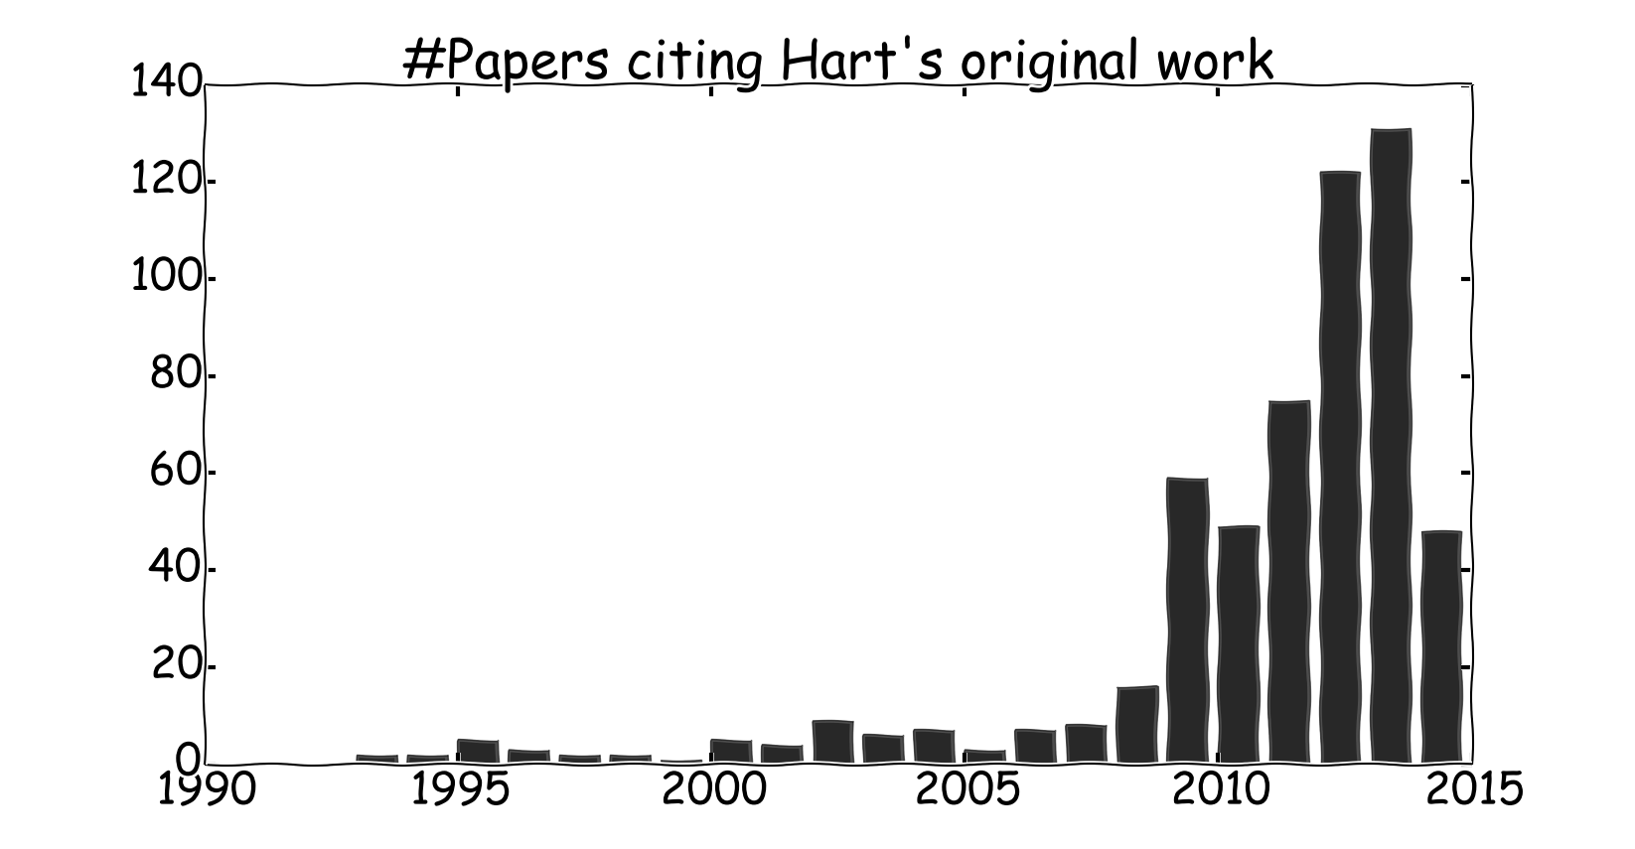
Giving credit where it is due

Slide 13
NILM interest explosion
National smart meter rollouts
Reduced hardware costs
International meetings
NILM workshop 2012, 2014; EPRI NILM 2013
Public datasets
Startups

Slide 14
“Data is the new oil”
9 NILM datasets and counting (few not specific to NILM)
Across 6 countries (India, UK, US, Canada, EU)
Measure aggregate and appliance level data
Across 3 colors ☺
REDD
BLUED
GREEND

Slide 15

The industry is interested!

Slide 16
So, is everything so rosy? Not quite! Else we won’t be here

Slide 17
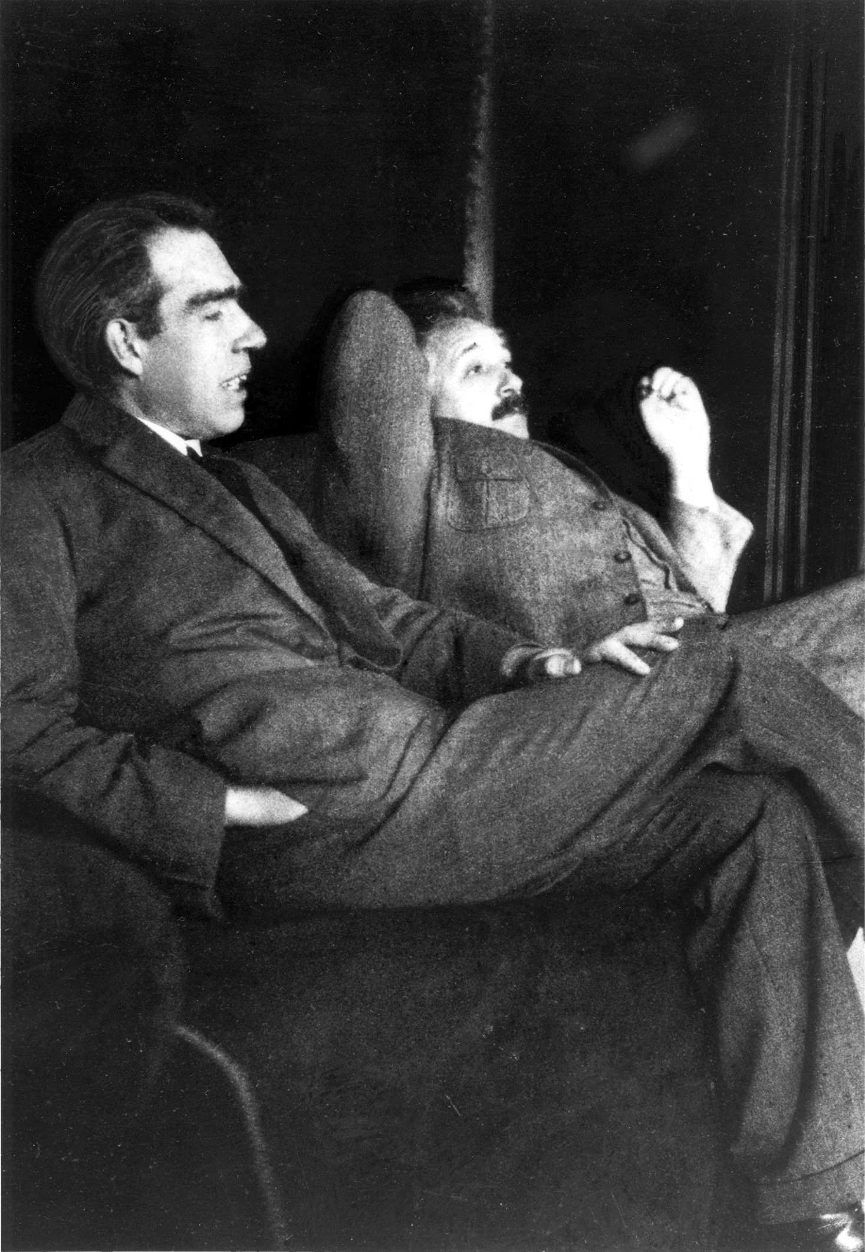
The scientific method
“The scientific method is a body of techniques for investigating phenomena, acquiring new knowledge, or correcting and integrating previous knowledge” as per wiki

Slide 18
3 core obstacles preventing comparison of state-of-the-art

Slide 19
1. Hard to assess generality
Subtle differences in aims of different data sets
Previous contributions evaluated only on single dataset.
Non-trivial to set up similar experimental conditions for direct comparison.

Slide 20
2. Lack of comparison against same benchmarks
Newly proposed algorithms rarely compared against same benchmarks.
Lack of “open source” reference algorithms → often lead to reimplementation.

Slide 21
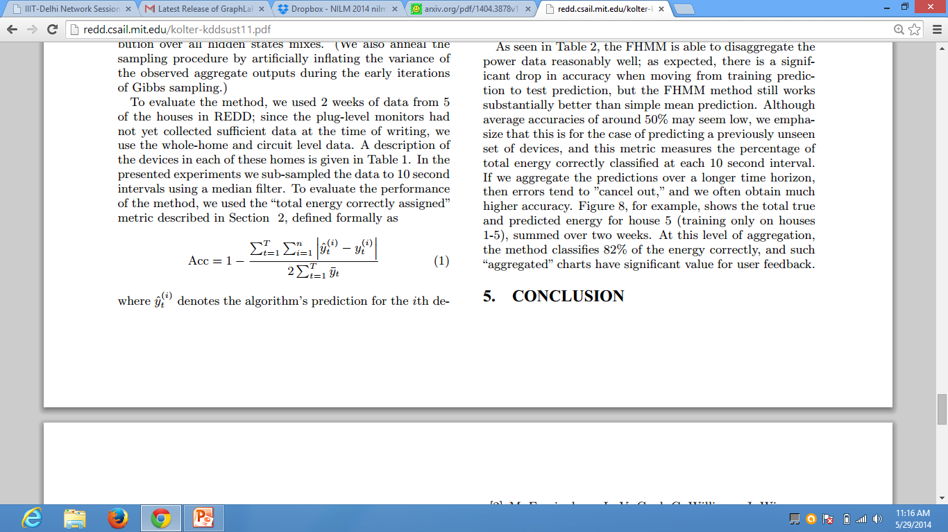
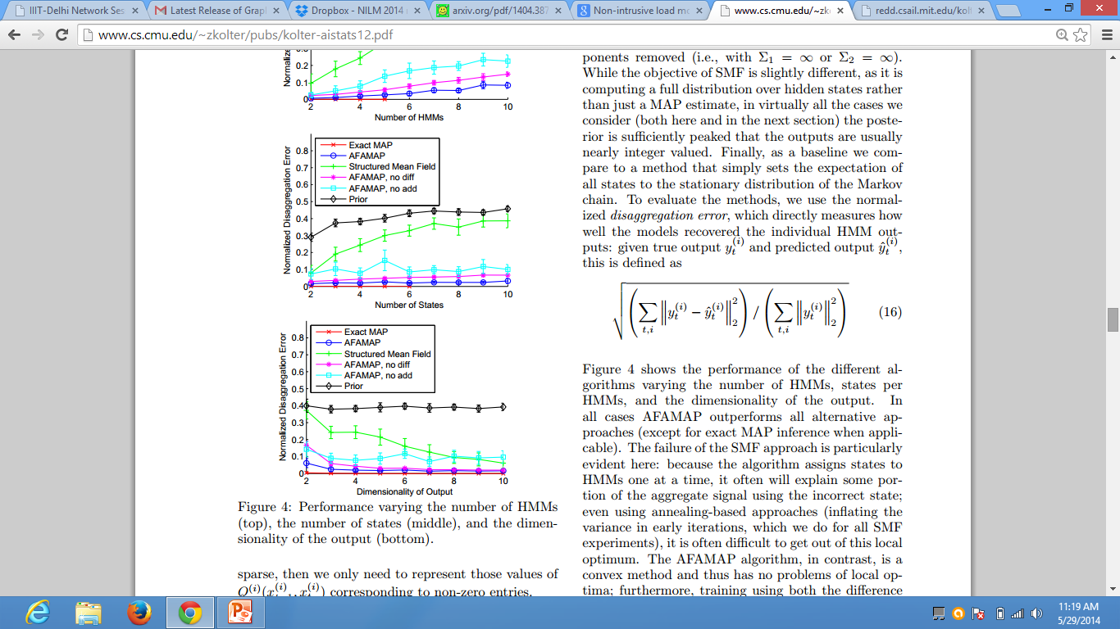
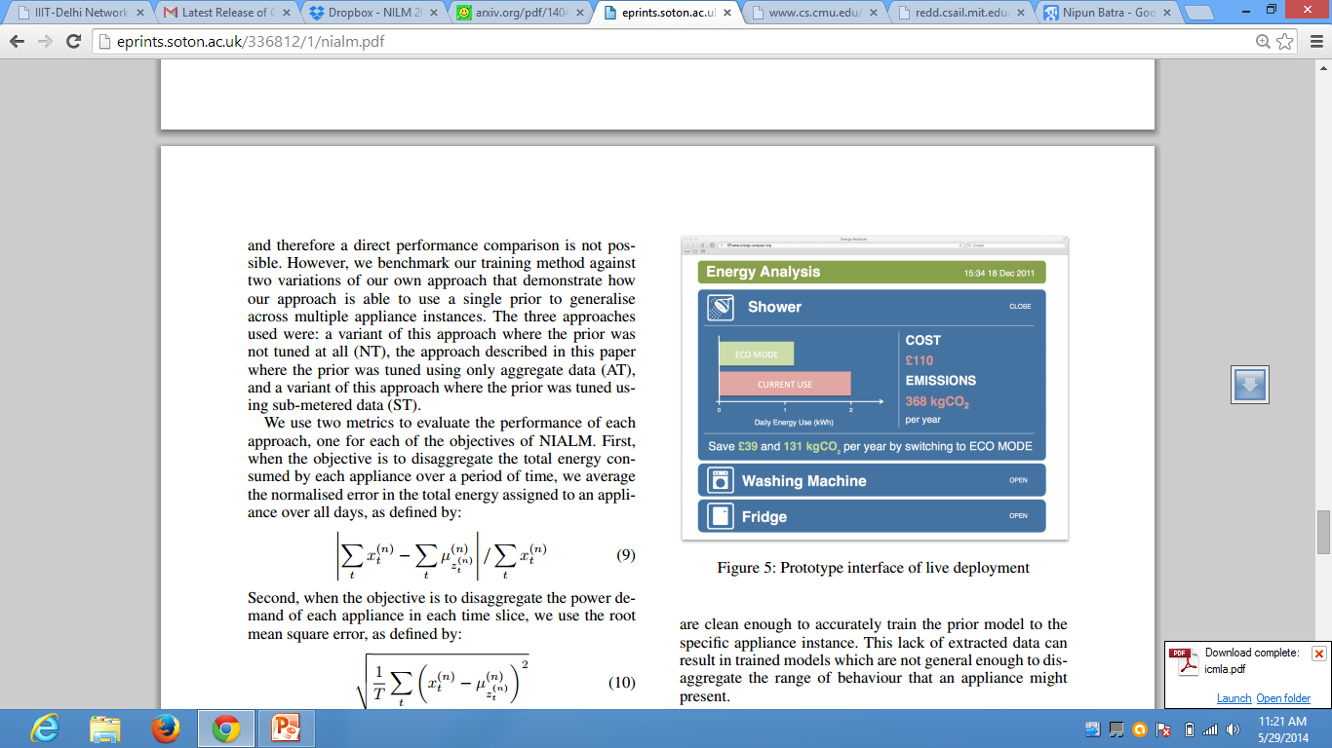
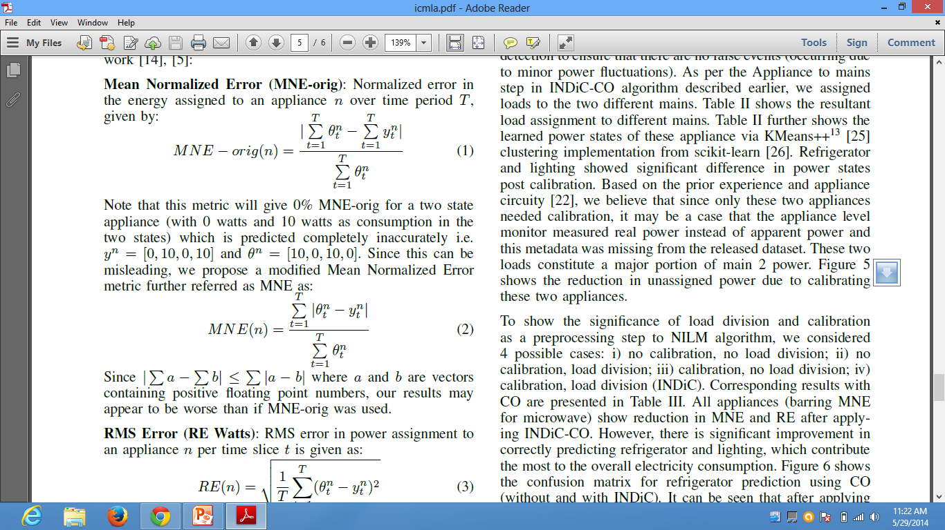
3. “Inconsistent” disaggregation performance metrics
Different performance metrics proposed in the past.
Different formulae for same metric, eg. 4+ versions of “energy assigned”

Slide 22

What is NILMTK?
Open source NILM toolkit

Slide 23
What does it do?
Enable easy comparative analysis of NILM algorithms across data sets.

Slide 24
How does it do that?
Provides a pipeline from data sets to metrics to lower the entry barrier for researchers.

Slide 25
NILMTK pipeline
Data interface
REDD
BLUED
Statistics
Training
Model
Metrics
UK-DALE
NILMTK-DF
Preprocessing
Disaggregation

Slide 26
Data Format
Data interface
REDD
BLUED
Statistics
Training
Model
Metrics
UK-DALE
NILMTK-DF
Preprocessing
Disaggregation

Slide 27
Data Format
We propose NILMTK-DF: a common data format.
Provide importers for 6 datasets: REDD, SMART*, Pecan street, iAWE, AMPds, UK-DALE
Both flat file and efficient binary storage format

Slide 28
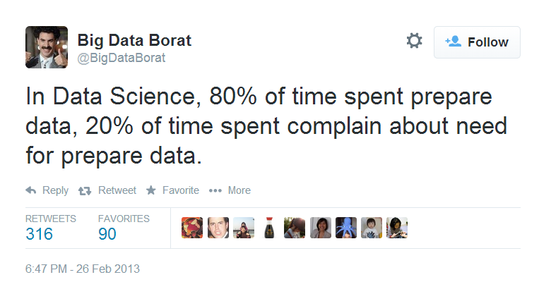
The fun of data!

Slide 29


Standardizing nomenclature
Refrigerator
Fridge
FGE

Slide 30
Metadata
Geographic coordinates
Type of appliance- hot, cold, dry?
Metering hierarchy
Parameters measured

Slide 31
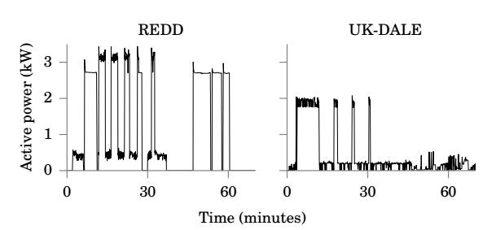
Standard nomenclature + Metadata + Datasets =
Comparing power draw of washing machines across US (REDD) and UK (UK-DALE)

Slide 32
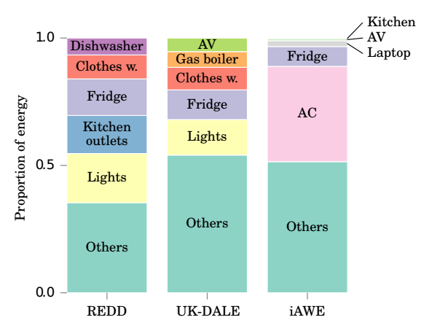
Standard nomenclature + Metadata + Datasets =
Top 5 appliance according to energy consumption across geographies
US
UK
INDIA

Slide 33
NILMTK pipeline
Data interface
REDD
BLUED
Statistics
Training
Model
Metrics
UK-DALE
NILMTK-DF
Preprocessing
Disaggregation

Slide 34
Statistics
Energy submetered: Sum of energy of all appliance/Energy at mains level
More energy submetered → More ground truth

Slide 35
Statistics
Appliance usage patterns
Correlations with weather
Appliance power demands

Slide 36
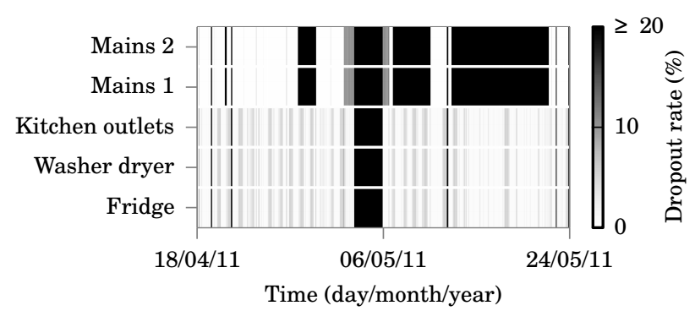
Diagnostics
Every data set has problems ☹ NILMTK provides diagnostic functions for common problems.
%Lost samples (per interval and whole), uptime
% lost samples in house 1 of REDD dataset

Slide 37
Preprocessing
Data interface
REDD
BLUED
Statistics
Training
Model
Metrics
UK-DALE
NILMTK-DF
Preprocessing
Disaggregation

Slide 38
Preprocessing
Correct common problems (as per diagnosis).
Other standard NILM preprocessors:
Interpolating, filtering implausible
Downsample to lower frequency
Select Top-k-appliances by energy consumption

Slide 39
Heart of NILMTK
Data interface
REDD
BLUED
Statistics
Training
Model
Metrics
UK-DALE
NILMTK-DF
Preprocessing
Disaggregation

Slide 40
Training
NILMTK provides two benchmark algorithms
Combinatorial optimization (CO) [Proposed by Hart]
Factorial hidden Markov model (FHMM) [More recent, more complex]

Slide 41
Model
Beyond the usual train and disaggregate, NILMTK allows importing and exporting learnt models
Allows NILM to be deployed in “real world settings”
Action speaks louder than words!! Demo follows!

Slide 42
Disaggregate!
Quite a bit of work before we disaggregate
We performed
CO and FHMM based disaggregation across first home of each dataset
Detailed disaggregation analysis across the home in iAWE (dataset from India)

Slide 43

Disaggregation across multiple datasets
CO as good as FHMM across iAWE, UKPD, Pecan datasets
Space heating contributes 60% in Pecan and 35% in iAWE. Both approaches able to detect with fair ease
And I thought that CO was really outdated…

Slide 44

Disaggregation across multiple datasets
FHMM outperforms CO across REDD, Smart*, AMPds
This is expected as FHMM models time variations.
CO exponentially quicker than FHMM

Slide 45


Detailed disaggregation in iAWE dataset (India)
CO and FHMM perform similar
Appliances such as air conditioners way easier to disaggregate
Complex appliances (laptops and washing machines) – not so good ☹

Slide 46
NILMTK pipeline
Data interface
REDD
BLUED
Statistics
Training
Model
Metrics
UK-DALE
NILMTK-DF
Preprocessing
Disaggregation

Slide 47
Metrics
NILMTK provides:
General machine learning metrics
Precision, Recall, F-score
Specialized metrics for NILM
Error in total energy assigned, RMS error in assigned power,..
Both event based and total power based NILM metrics.

Slide 48
Demo time!!

Slide 49
Conclusions
Three core challenges in NILM research
Hard to address generality
Lack of comparison against same benchmarks
Inconsistent disaggregation performance metrics
How NILMTK addresses these challenges
Standard input and output formats (Addresses #1)
Parsers for 6 NILM data sets (Addresses #1, #2)
Two benchmark NILM algorithms (Addresses #1, #2)
Statistics, diagnostics and preprocessing (Addresses #1, #2)
Metrics for different NILM use cases (Addresses #1)

Slide 50
Backup

Slide 51
Combinatorial optimization
Seeks to find the optimal combination of appliances’ power draw to minimize residual energy.
Similar to subset-sum problem and thus NP-complete ☹
Power draw is not related in time

Slide 52
Combinatorial optimization
Appliance | Off power | On power
Air conditioner (AC) | 0 | 2000
Refrigerator | 0 | 200
If total power observed = 210 → AC is OFF and Refrigerator is ON

Slide 53
Combinatorial optimization
Appliance | Off power | On power
Air conditioner (AC) | 0 | 2000
Refrigerator | 0 | 200
If total power observed = 2000 → AC is ON and Refrigerator is OFF

Slide 54
Combinatorial optimization
Appliance | Off power | On power
Air conditioner (AC) | 0 | 2000
Refrigerator | 0 | 200
If total power observed = 2230 → AC is ON and Refrigerator is ON

Slide 55
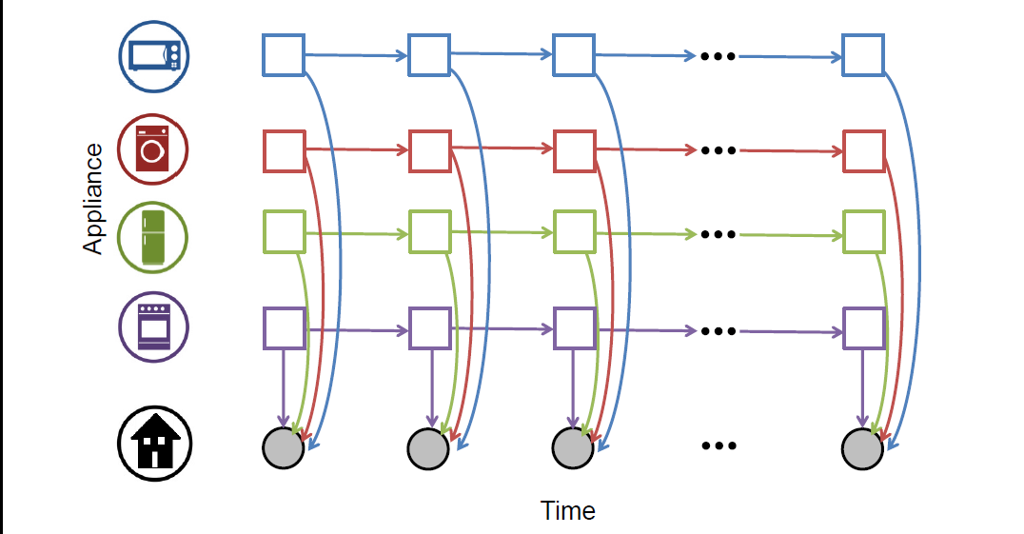
FHMM
Each appliance modeled as HMM
Power draw related in time→ If TV is on right now, likely to be on next second.
Exact inference scales worse than CO

Slide 56
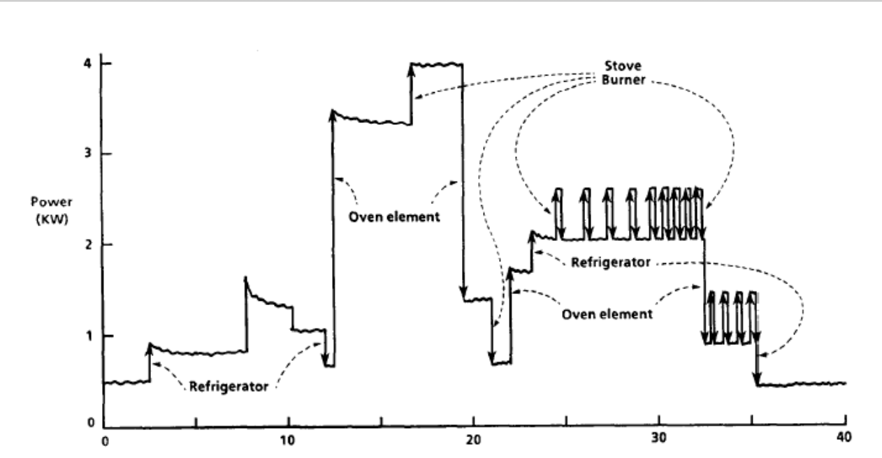
A bit of history
Seminal work on NILM done at MIT dates back to early 1980s – A good 6-7 years before I was born!

Slide 57
Field progress
What happened here?

